Slide 2
Aarogya – A Complete HMIS Solution
Aarogya, the Medical ERP, boxes a fully integrated state of art Hospital Management Information System (HMIS) for mid-size to large hospitals, Investigations labs and polyclinics.
The solution is modular and gives healthcare organizations the convenience of flexible rollout strategy.

Slide 3
Core Modules
O.P.D
I.P.D.
O.T. Management
Radiology / Pathology
Organization/TPA
Pharmacy
Inventory
Financial Accounts
M.I.S

Slide 4
Add-on Modules
SMS Module
Nursing Station
Asset /Machine Maintenance
C.S.S.D
Biomedical Waste
Dietary
Blood Bank
Payroll

Slide 5
O.P.D. Management
O.P.D. Registration
Allocate Patient Unique Hospital Identification Number (UHID)
Record Patient Demographic Details
OPD Pre-Appointment / Online Appointment System
Outpatient Billing
Consultant Prescription Order Entry
Case / Department / Consultant wise Reports
Gender wise Report
Track Old Patient History

Slide 6
I.P.D. Management
Admission, Discharge and Transfer (A/D/T)
Bed Occupancy Matrix
Payment Receipts
Medical Observation and Nursing Notes
Admission / Discharge Statistics
Medical Certificates, Birth / Death Certificates
Patient Dues Report
Discharge Summary & Billing
Consultant Dashboard
Track Patient History

Slide 7
O.T. Management
O.T. Reservation for a scheduled surgery
Team of Doctors/ Assistants involved in the operation
Consent Forms (Bilingual)
Record Operation Notes
Store Pre-operative / Post Operative Images
Record Pre-Anesthesia / Operation Consents
Track Consumables Used in OT
Bill Charges Posting (Surgery & Package Surgeries)

Slide 8
C.S.S.D.
Maintain Equipment Details & Stock
Receive Request for Equipment from O.T. Department
Allot Instruments against any Surgery
Receive Instruments from O.T. post Surgery
Sterilization of Instruments received after O.T.
Follow Different Sterilization Process

Slide 9
Radiology / Pathology
Define Sub Specialties
Create Test Report Templates
Investigation Sample Collection
Bar Code Generation
Referral Accounting
Collection Centre Accounting
Generate Investigation Reports
Consultant wise Test Report
Test Category wise Analysis
Stock Consumption

Slide 10
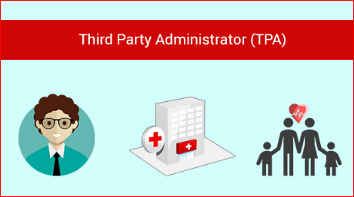
Organization/ TPA Module
Create Organization / TPA Master
Define Organization wise Rates / Discount Structure
Organization / TPA Limit Approval Tracking
Submit Bill to Organization / TPA for payments
Bill Adjustments after Patient Discharge
Organization / TPA wise Outstanding
Integrated with Finance module

Slide 11
Pharmacy Module
Purchase Indents & Ordering
Goods Receipt Notes/ Purchase Returns
Medicine Supplies to patients & Wards
Batch & Expiry Management
Fast Moving/ Non Moving Drugs
Stock Transfer between Sub-Stores
Stock Reorder Reports
Drug Stocks (Company / Composition / Category wise)
Stock Ledgers and Stock Valuation
ABC / FSN / XYZ/HML Sales Analysis

Slide 12
Inventory Management
Purchase Indents & Approval
Quotation Tracking
Purchase Order Generation & Approval
Goods Receipt & Auditing
Purchase Returns
Stock Transfer to departments
Stock Reorder Reports
Stock Ledgers and Stock Valuation
Supplier Accounting

Slide 13
Financial Accounts
Financial Posting from other modules
Department / Head wise collections
Journal Voucher Entries
Cash / Bank Payments to suppliers
Bank Reconciliations
Credit Notes / Debit Notes
Trial Balance
Profit & Loss and Balance Sheet
Audit Trail from Financial Books to Ledger Entries

Slide 14
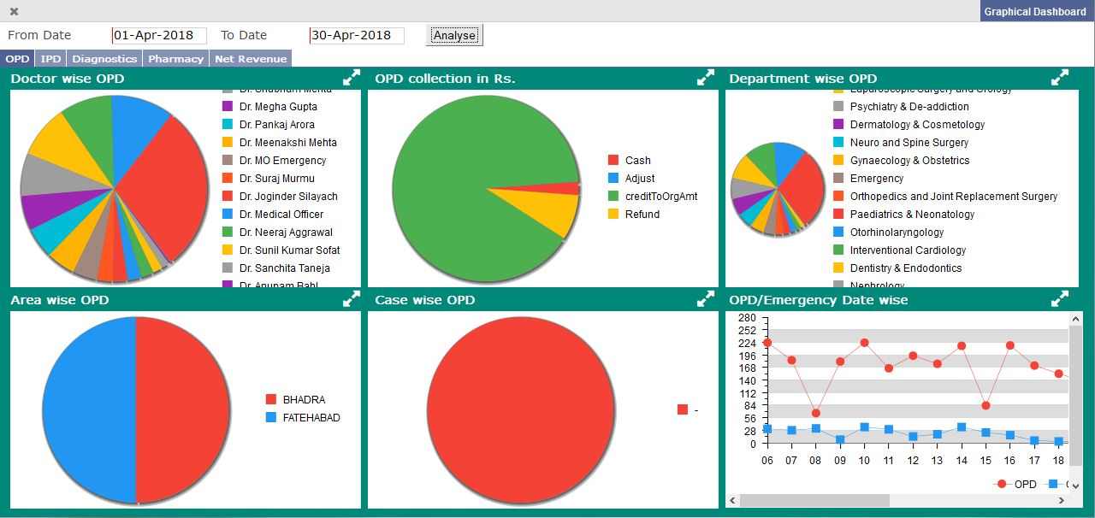
M.I.S. Reports
Patient History Tracking
Graphical Dashboards
Collection Reports
Department wise Sales
Daily OPD / IPD Report (Department wise)
Bed Occupancy Analysis (Floor wise / Nursing Station wise)
Daily Activity Summary (for Top Mgt.)
Clearance Check List
M.I.S. on Mobile

Slide 15
Nursing Station Module
Nursing Station Instructions
Nursing Instruction Follow-ups
Patient Routine Check-up
Medicine Advice & Auto Display at Medicine Store
Lab Advice & Auto instructions to Lab Counter
Pending/Completed Job Status
Nurses Job Mismatch Report

Slide 16
SMS Module
User Defined SMS Templates
SMS to OP / IP Patients / Team of Doctors
Send Birthday / Anniversary SMS
Send Reminder / Appointment Messages
O.T. Booking Message to Surgeon, Anesthetist, Attendants

Slide 17
Asset / Machine Maintenance
Asset / Machine Master
Machine Up/Down Tracking
Machine Log /Maintenance Due Reminders
Asset Transfer / Repair/ Condemnation
Asset Appreciation/ Depreciation

Slide 18
Housekeeping
Location Master with Housekeeping work Define
Check List for Room Preparation / Cleaning
Daily Housekeeping Activity
Stock Management
Lost & Found Tracking

Slide 19
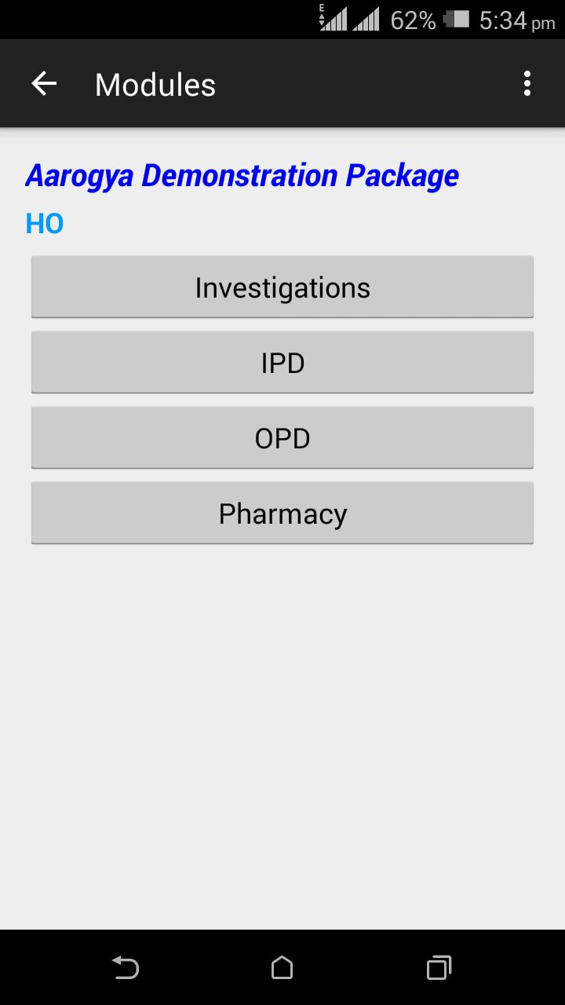
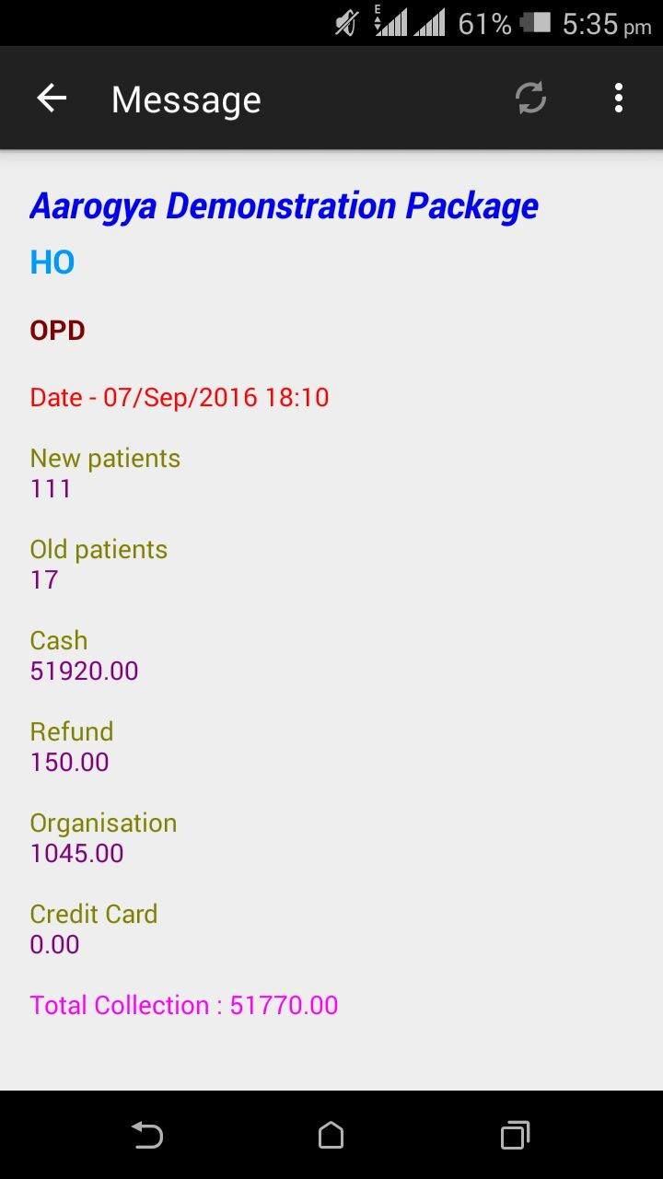
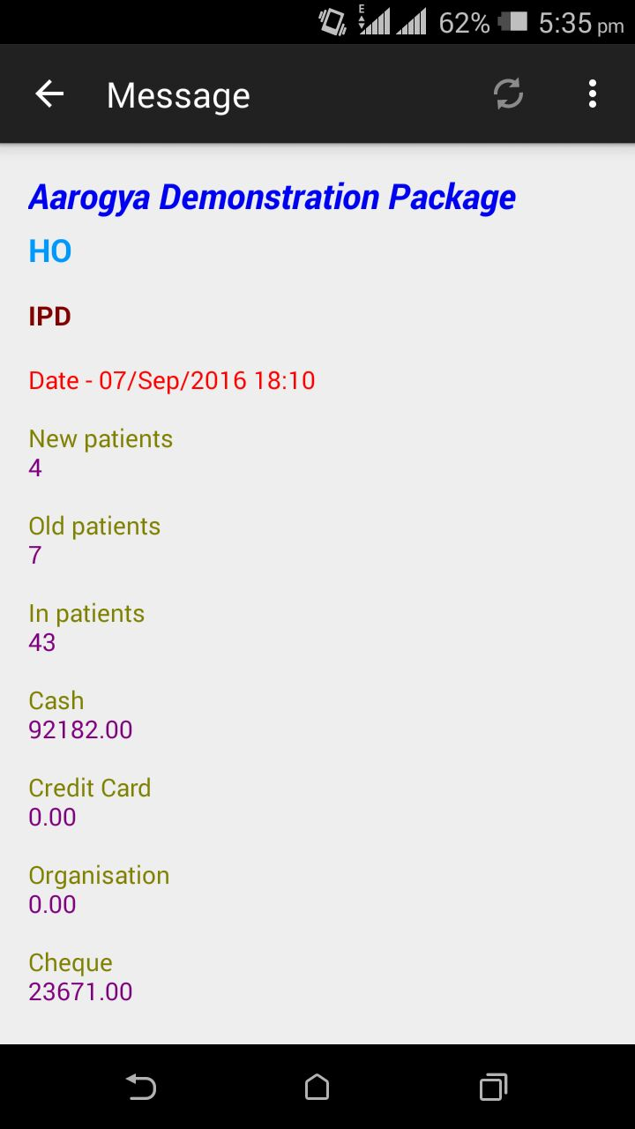
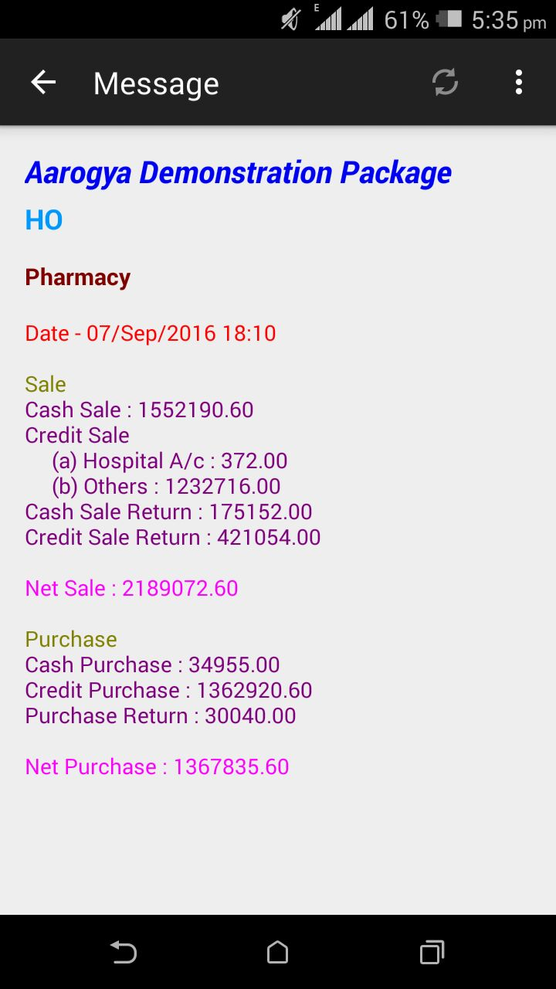
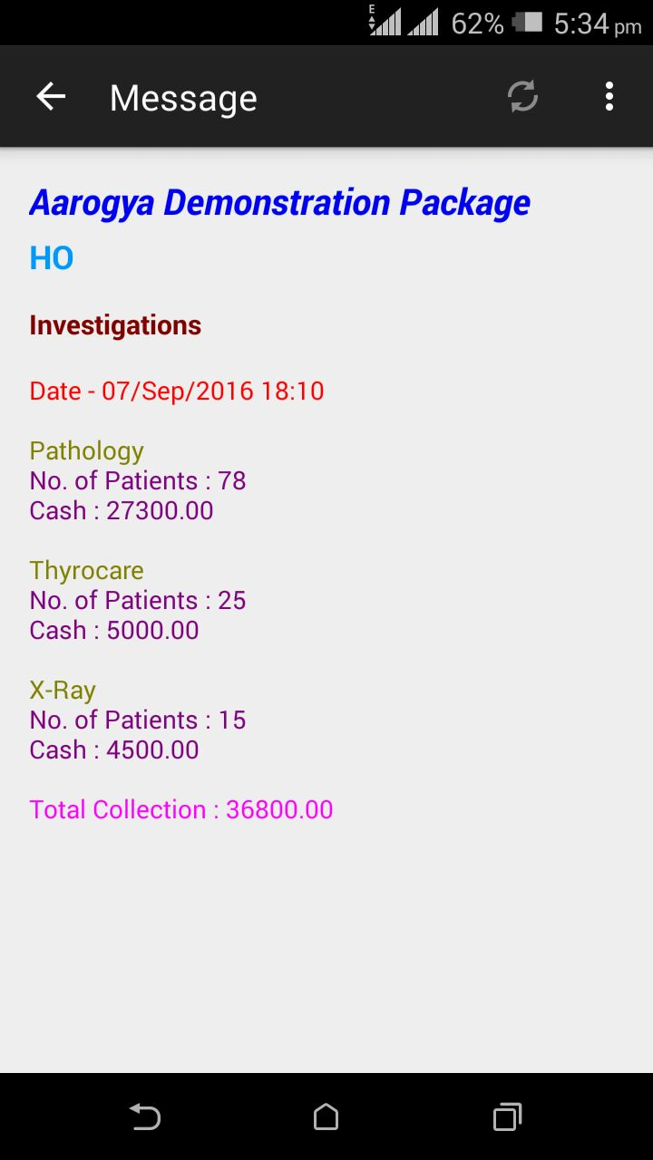
MIS on Mobile (Android/iOS)

Slide 20
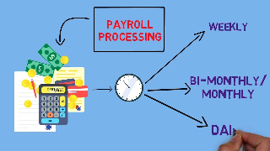
Payroll Management
Employee Personal Details
Shift Defining
Duty Roaster Tracking
Attendance Management
Leaves/Holiday Accounting
Allowances & Deductions
Loans and Advances Management
Employee Promotion, Transfers & Resignation
Payroll Processing
Statutory Reports

Slide 21
Dietary Management
Diet Category ( Liquid Diet / Solid Diet / Normal Diet…)
Diet Item Master Creation
Meal Time & Schedule Defining
Diet Template Creation
Patient wise Diet Instructions
Diet Delivery Dashboard
Pending / Delivered Report

Slide 22
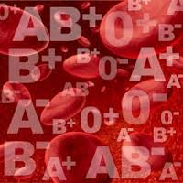
Blood Bank
Blood Group wise Donor Information
Donor Card Generation
Blood Group wise Receipts
Record Blood Transfusions
Blood Group wise Stocks
Test Count Registers
Camp Organization & Details
Daily Quality Check Updations
Blood Expiry Tracking
Test Analysis

Slide 23
Interfaces
Token Display
Barcode
Webcam
Smart Card
SMS / Email
Mobile MIS [Android / iOS/ Windows]
Bio Metric Devices
Tally Accounts
LAB Equipment (Unidirectional / Bidirectional)
Kiosk

Slide 24
Aarogya Advantage
30+ Years Experience in Software Domain
Successfully executed at more than 1500 Healthcare Clients
Supported by Strong Team of 250 Professionals
Configurable Multi Level Security
User Friendly Interface to increase Staff Efficiency
Real-time Business Monitoring
Better Quality of Care, Service to Patients
Reduce Operating Costs
Control Pilferages & Leakages
Comprehensive reporting and analytics System

Slide 25
01
02
03
Focus on organic growth
Clientele in 15 countries and 22 states of India
Over 15% Growth in 2018-19
Founded in 1990 in India
Specializes in providing flexible business-oriented solutions.
Significant cash reserves & zero debt
The Company
Over 5000 Clients
Spread in 140 Cities
04
05
06
Functional expertise in Healthcare, Hospitality, Education, Construction
Expertise on .NET, Open source, Mobile, Desktop & Web Application.
Customer centric onsite offshore model with focus on quality & Security Process

Slide 26
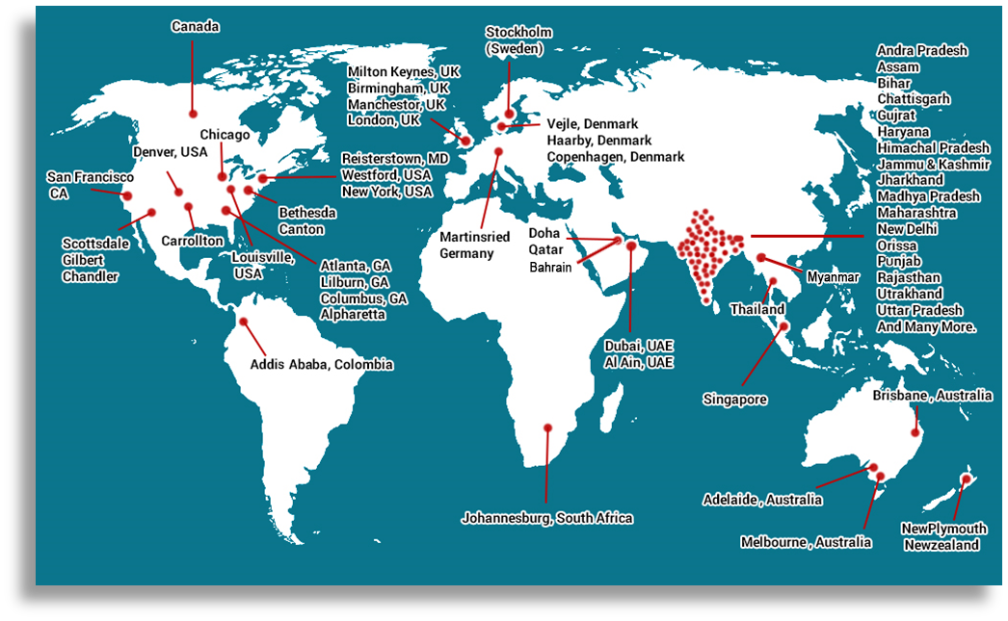
The Clients – Geographically

Slide 27
Certifications & Empanelment's
Certifications
Empanelment's
Technical Trading Empanelment's
CMMi Level 5
NSIC Empaneled Company
NSE (National Stock Exchange) Empaneled Vendor For Share Trading/Finance Related Software Provider
ISO 9001 for Quality Assurance
STPI (Software Technology Park of India)
ISO 27001 for Security Assurance
Department of Telecommunication
NCDEX
Ministry of Social Justice & Empowerment

Slide 28
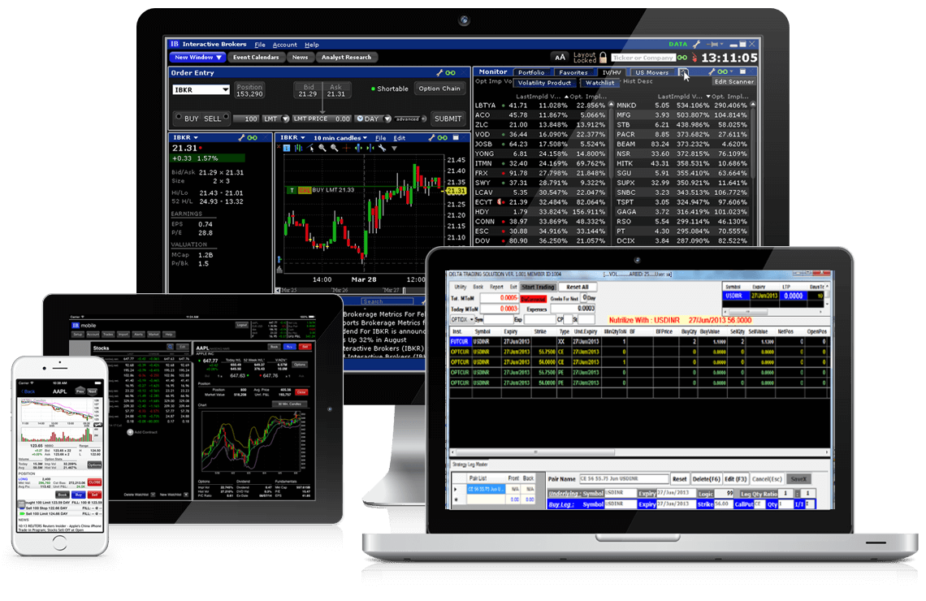
Dataman Domain Experience
Complete Health Care Products for Hospitals, Clinics, Diagnostics Center with over 2000 Installations
Hospitality and Entertainment Industry Products for Hotels, Restaurants Clubs, Resorts, POS with over 1800 Installations
Education Industry products – for Professional Colleges, University, Degree Colleges and Schools 500+ Installations
Supply Chain Products from Manufacturer, Distributor, Retailers with sales force automation products– Nearly 2000 Installations
For Real Estate, Construction and Contractor ERP – 100+ Installations
For Manufacturing and Packaging units complete ERP products for Paper Mills, Flour and Rice Mills, Oil Extraction Plants, Leather and Leather Item Manufacturers
Financial Market Systems including Automated Trading, Risk Management System, Online Trading System, Dealer Management, High Frequency Trading System for Forex, Commodity, Stocks, Future and Option Market

Slide 29
www.dataman.in
Office : Kanpur | Delhi | Mumbai | Chandigarh
Thank You

